Slide 1
Google Data Analytics Capstone Project
Made by : Hazem Hamdan

Slide 2
About the Company
> Cyclistic is a bike-sharing company that launched in 2016 with 5,824 bicycles and 692 stations in Chicago.
> Their marketing strategy has focused on attracting customers through flexible pricing plans.
> However, they found that annual members are more profitable than casual riders.
> Now, Cyclistic wants to convert casual riders into annual members by designing targeted marketing strategies.

Slide 3
Tasks
1. Maximize the number of annual memberships for future success.
2. Understand how casual riders and annual members use Cyclistic bikes differently.
3. Design a new marketing strategy to convert casual riders into annual members.
4. Back up recommendations with compelling data insights and professional visualizations to gain approval from Cyclistic executives.

Slide 4
The Data
- I am working with the company data for every month of the year 2022.
- In this project I used : Excel, SQL, Power BI.

Slide 5
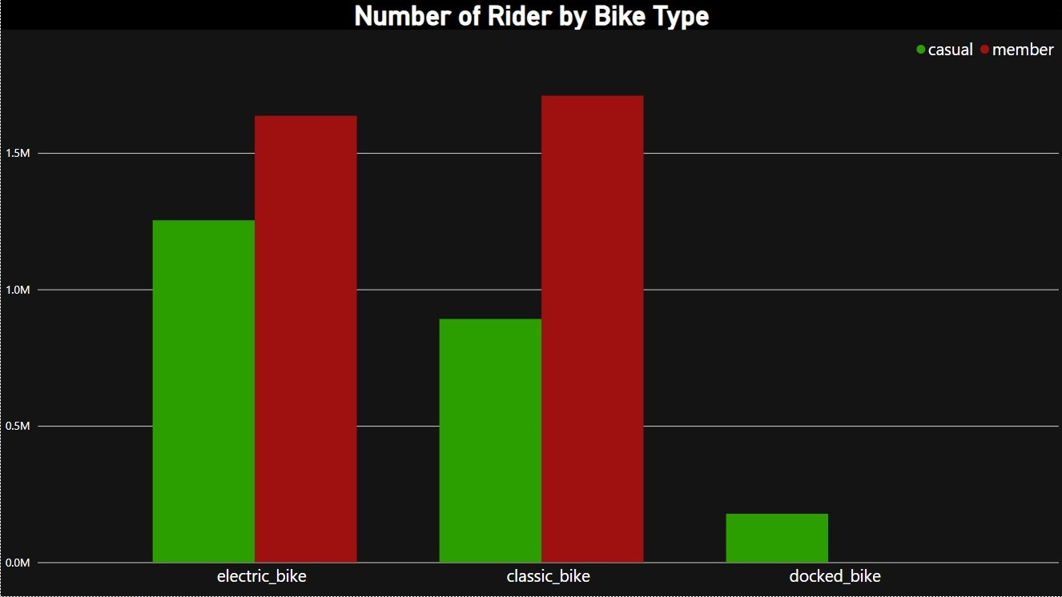
The number of Rider by Bike Type

Slide 6

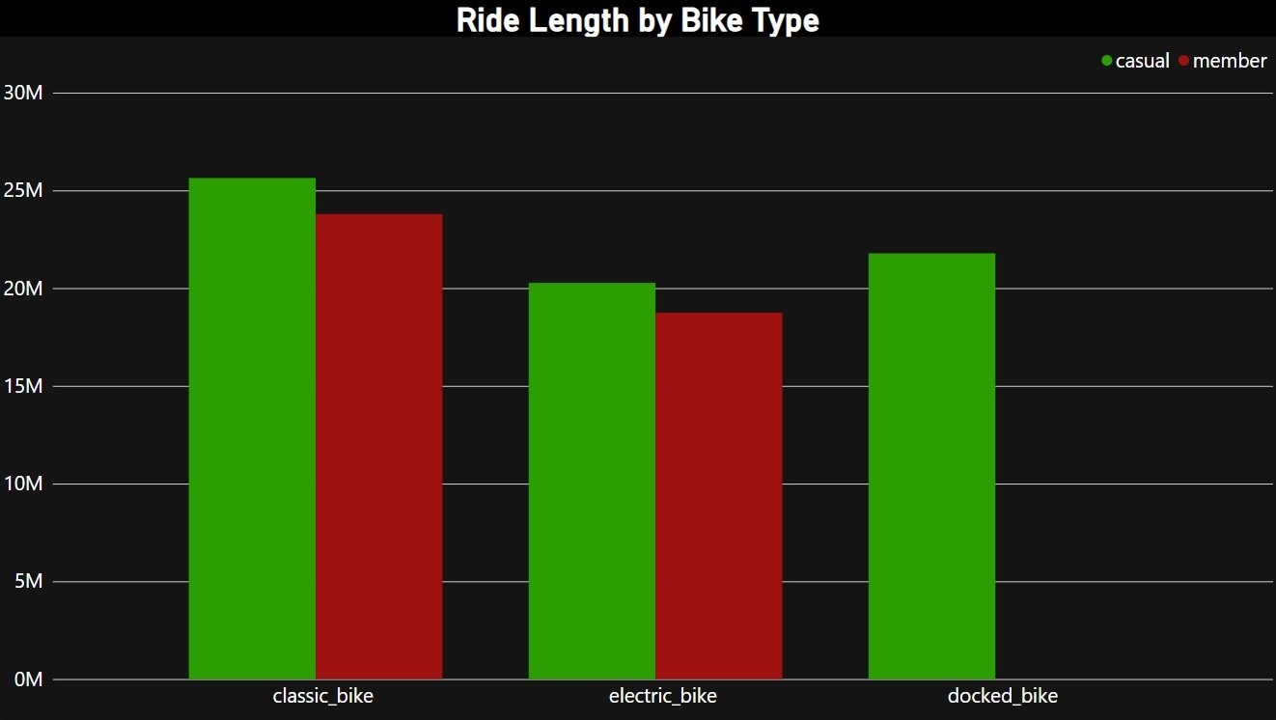
Ride Length by Bike Type per Week

Slide 7
Key Findings
1- We can observe from the first and second graphs that casual riders tend to use docked bikes, while annual members never use them.
2- In addition, casual riders use bikes for longer distances compared to members.

Slide 8
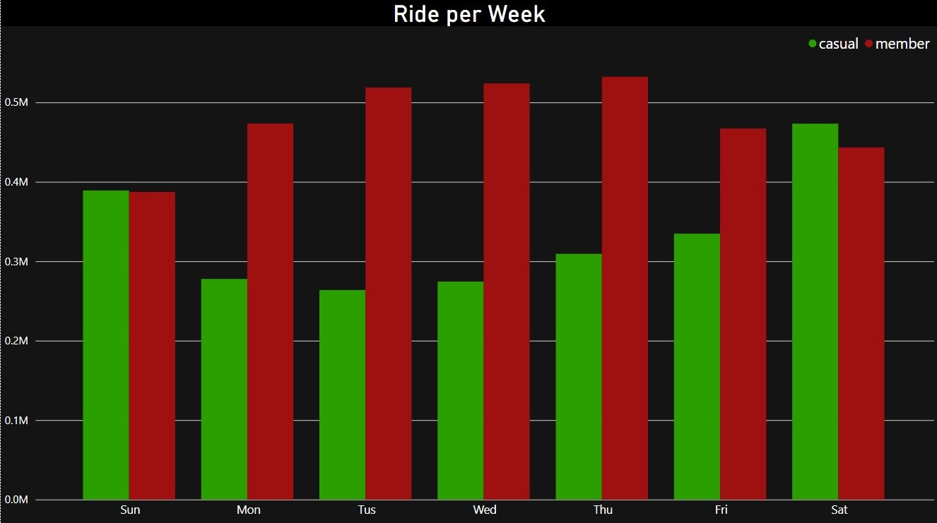
The number of Rider per Week

Slide 9
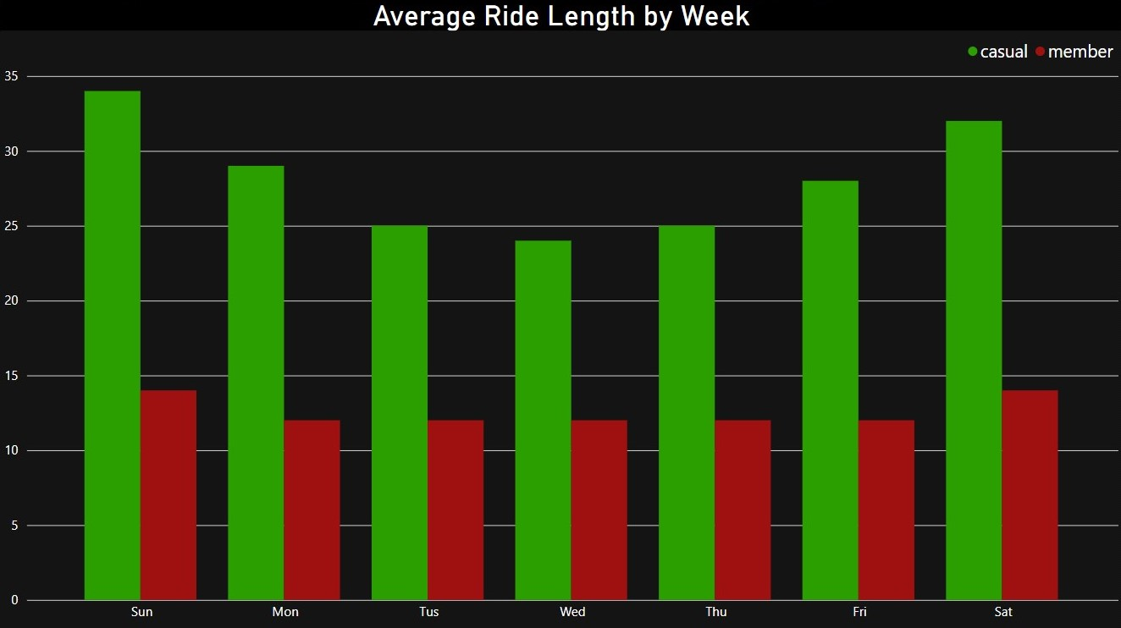
Average Rides Length per Week

Slide 10
Key Findings
1- From the third and fourth graph, we can see that casual riders prefer to use bikes on Saturdays and Sundays, which are weekends.
2- For annual members, they use bikes on weekdays, from Monday to Friday.

Slide 11
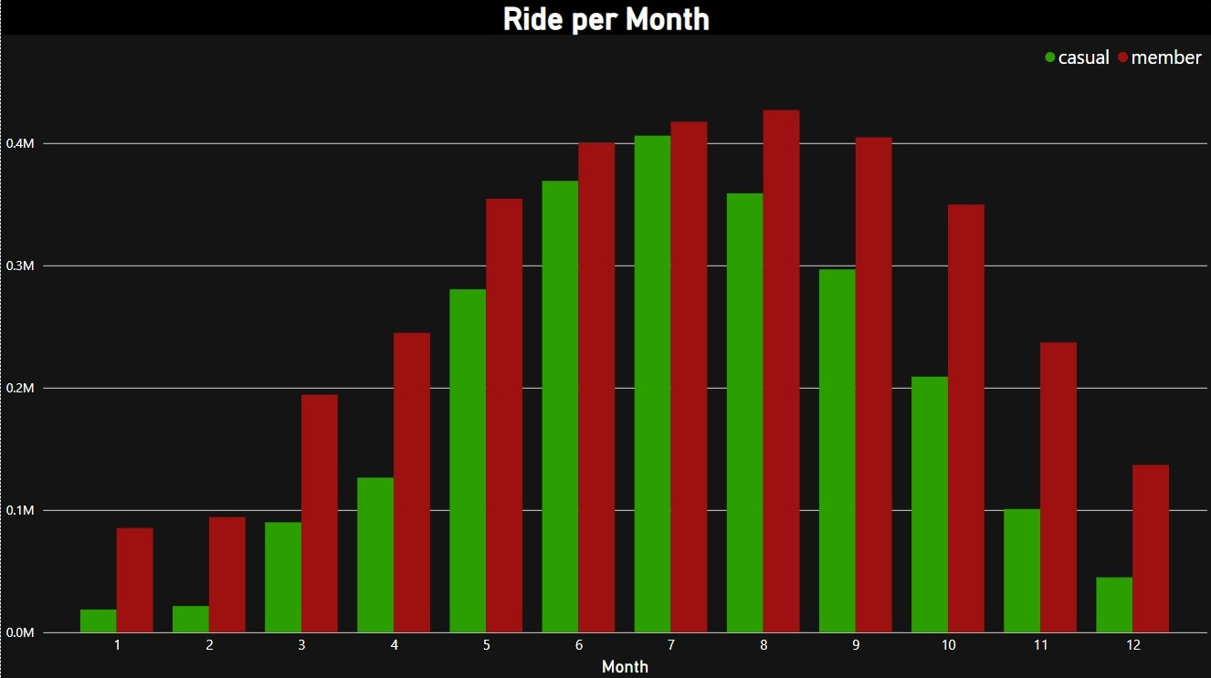
The number of Rider per Month

Slide 12
Key Findings
1- For the last graph, it is evident that casual riders' bike usage increases during the hot months, which are June, July, and August.

Slide 13
Recommendation
> Create marketing plans during the summer that focus on attracting casual users, and these plans can be prepared during the winter period.
> Add offers for annual members on weekdays, such as special pricing or discounts for long distances, to attract casual users to subscribe.
> Focus advertisements on promoting subscriptions when using Docked bikes.

Slide 14
Thanks for Your Time

